Slide 1

YSC2239 Lecture 3

Slide 2
Today’s class
Arrays
Creating new tables
Manipulating columns of tables
Reading: Chapter 5, 6.1, 6.2

Slide 3
Arrays

Slide 4
Arrays
An array contains a sequence of values
All elements of an array should have the same type
Arithmetic is applied to each element individually
Adding arrays adds elements (if same length!)
A column of a table is an array
(Demo)

Slide 5
Ranges
A range is an array of consecutive numbers
np.arange(end): An array of increasing integers from 0 up to end
np.arange(start, end): An array of increasing integers from start up to end
np.arange(start, end, step): A range with step between consecutive values
The range always includes start but excludes end

Slide 6
Building Tables

Slide 7
Ways to create a table
Table.read_table(filename) - reads a table from a spreadsheet
Table() - an empty table
and… select, where, sort and so on all create new tables

Slide 8
Example

Slide 9
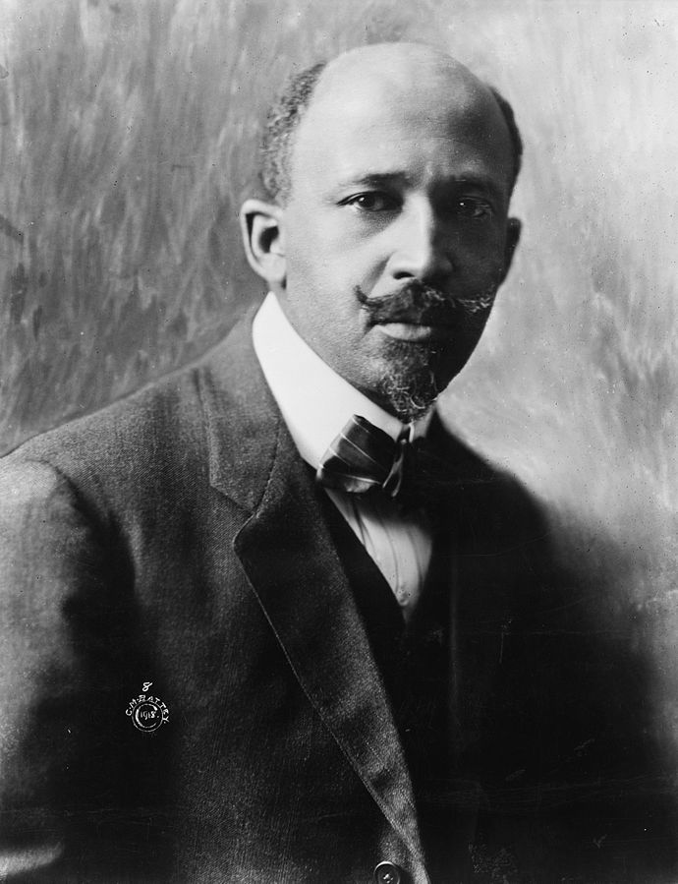
W. E. B. Du Bois, 1868-1963
Scholar, historian, activist, and data scientist
NAACP founder
Made a series of visualizations for the 1900 Paris Exposition
Goal: change the way people see Black Americans
Hundreds of photographs and patents
60+ handmade graphs in 3 months

Slide 10
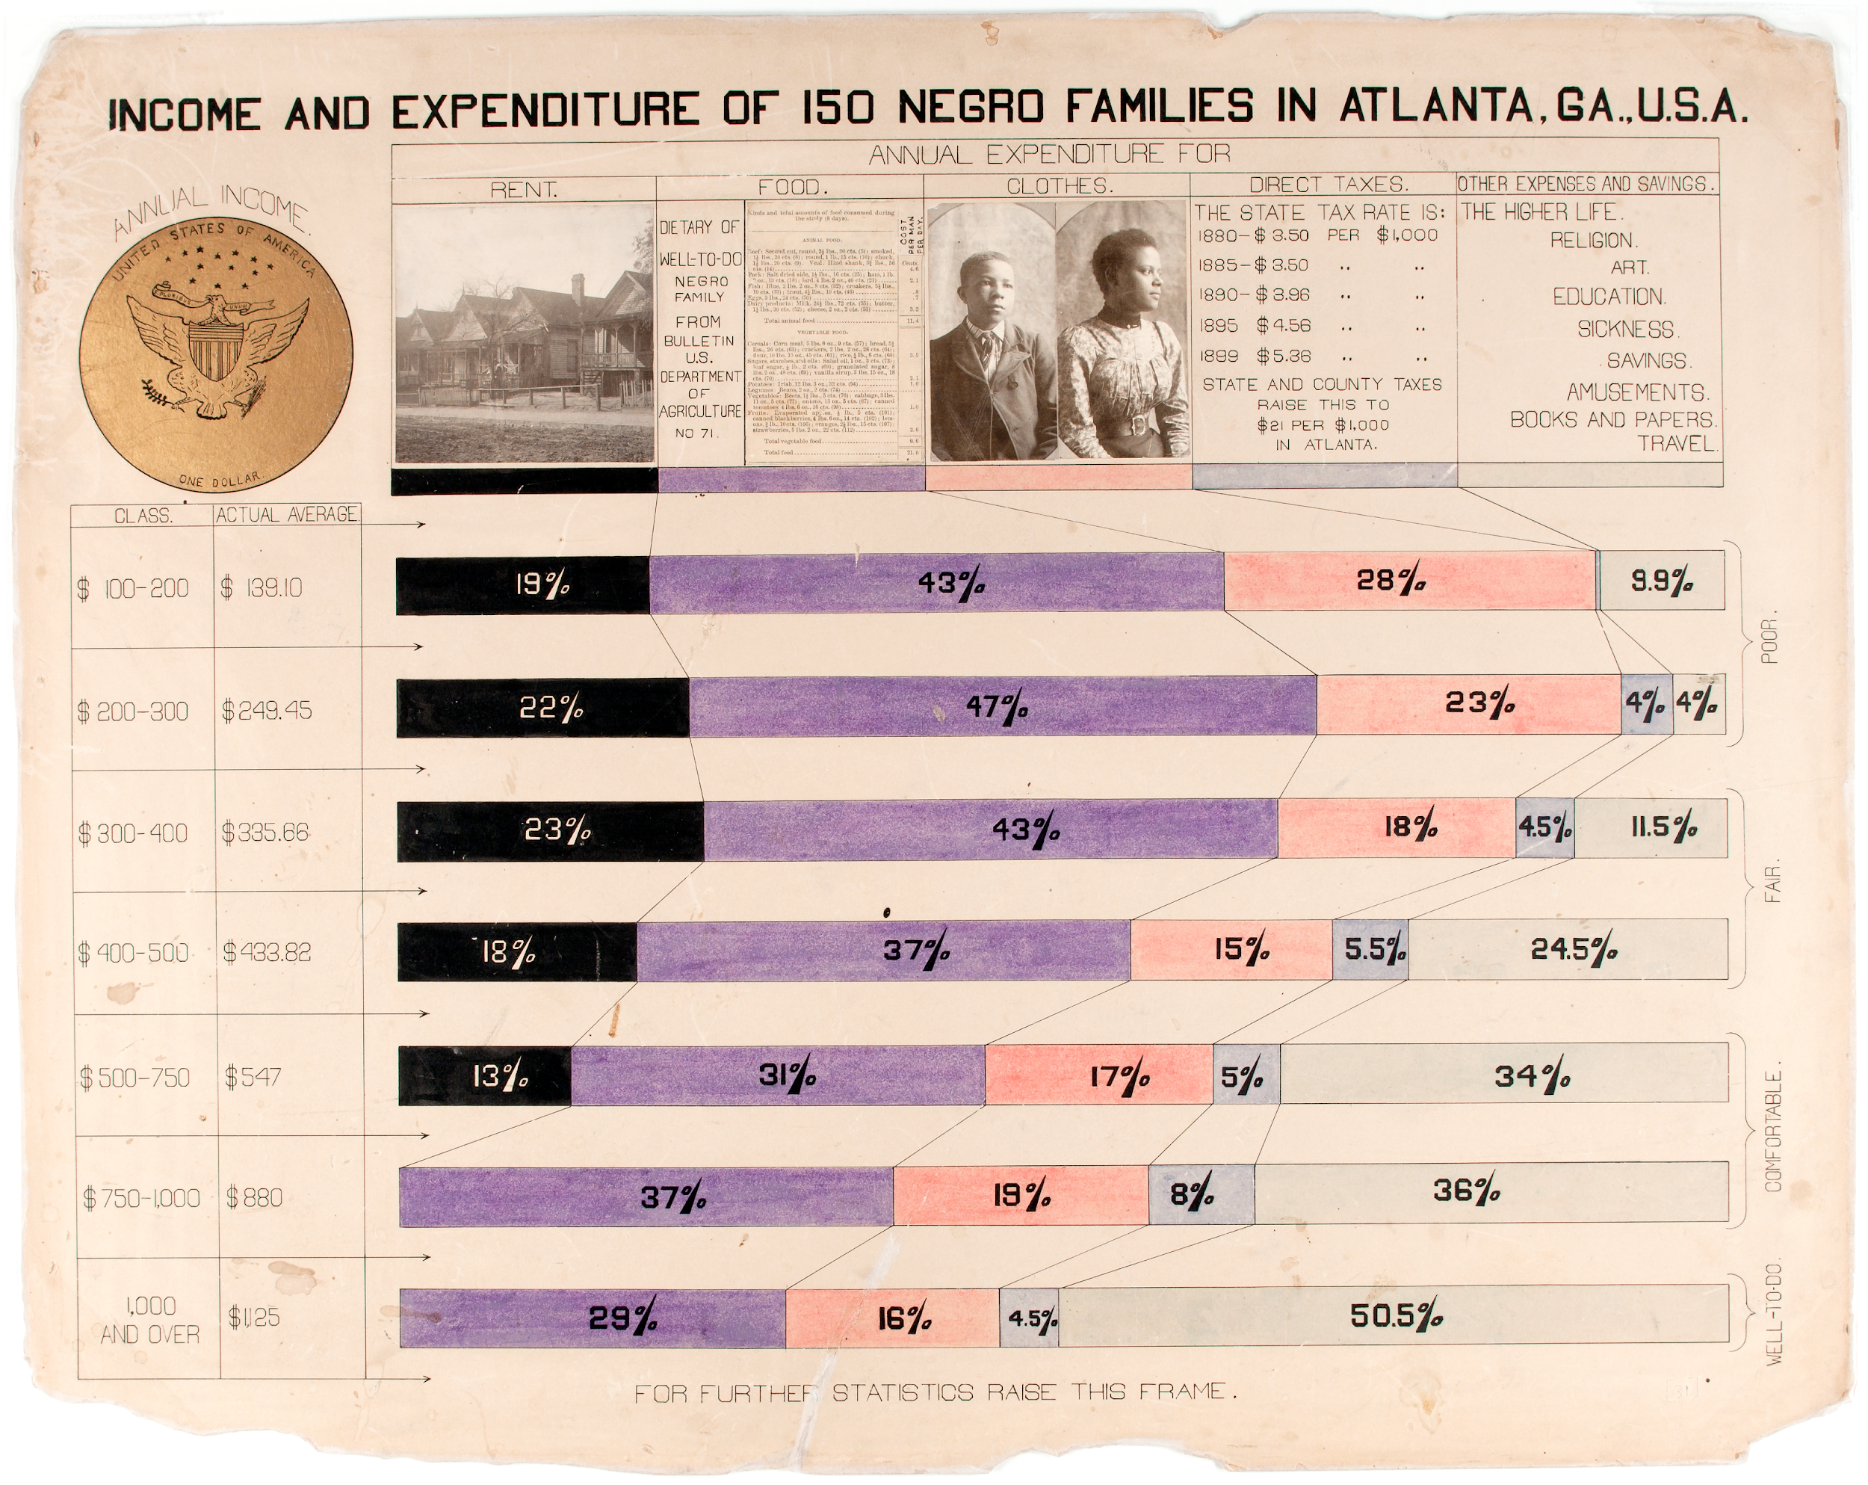
(Demo)

Slide 11
Discussion Question
Use the table functions we learned this week to find the income bracket (“class”) that spent the highest percentage of their income on rent.

Slide 12
Table Methods
Creating and extending tables:
Table().with_column and Table.read_table
Finding the size: num_rows and num_columns
Referring to columns: labels, relabeling, and indices
labels and relabeled; column indices start at 0
Accessing data in a column
column takes a label or index and returns an array
Using array methods to work with data in columns
item, sum, min, max, and so on
Creating new tables containing some of the original columns:
select, drop
(Demo)

Slide 13
Manipulating Rows
t.sort(column) sorts the rows in increasing order
t.sort(column, descending=True)sorts the rows in decreasing order
t.take(row_numbers) keeps the numbered rows
Each row has an index, starting at 0
t.where(column, are.condition) keeps all rows for which a column's value satisfies a condition
t.where(column, value) keeps all rows for which a column's value equals some particular value
Same as t.where(column, are.equal_to(value))

Slide 14
Discussion Questions
The table nba has columns PLAYER, POSITION, and SALARY.
Create an array containing the names of all point guards (PG) who make more than $15M/year
guards = nba.where('POSITION', 'PG')
guards.where('SALARY', are.above(15)).column('PLAYER')
b) How to combine two tables into one?
nba.where(‘POSITION’,’PG’）.append(nba.where(’POSITION’,’C’).show(100)
(Demo)

Slide 15
Attribute Types

Slide 16
Types of Attributes
All values in a column of a table should be both the same type and be comparable to each other in some way
Numerical — Each value is from a numerical scale
Numerical measurements are ordered
Differences are meaningful
Categorical — Each value is from a fixed inventory
May or may not have an ordering
Categories are the same or different

Slide 17
To do
Lab 2 already posted on Canvas and due on Wednesday

